Slide 1

Q1 Business Performance Review
Quarter Ending March 31, 2025

Slide 2
Executive Summary – Q1 Performance
Total Revenue: $15.43M
Total Cost: $4.95M
Net Profit: $10.48M
Profit Margin: 67.9%
Total Customers: 1,545

Slide 3
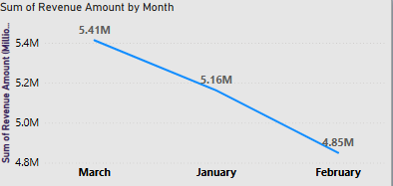
Revenue Trend by Month
January: $4.85M
February: $5.16M
March: $5.41M
Steady month-over-month growth observed

Slide 4
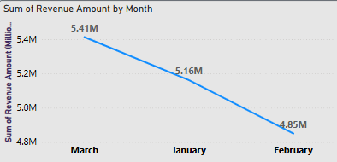
Channel-wise Revenue Distribution
Direct Sales: $5.31M
Online Inquiry: $5.15M
Partner Referral: $4.97M
Balanced contribution across channels

Slide 5
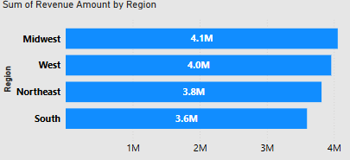
Regional Revenue Comparison
Opportunity: Grow presence in the South
Midwest: $4.1M
West: $4.0M
Northeast: $3.8M
South: $3.6M

Slide 6
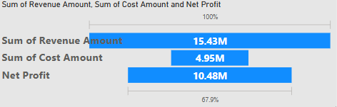
Cost Breakdown and Efficiency
Total Cost: $4.95M
Cost-to-Revenue Ratio: 32.1%
Controlled spend driving high margin

Slide 7

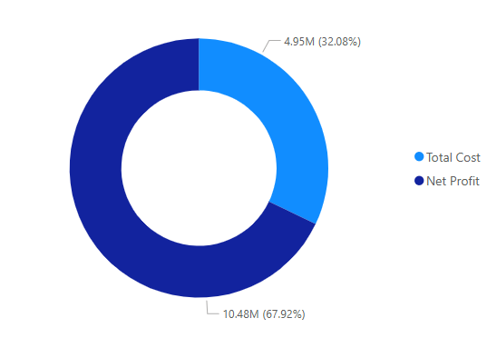
Profitability Analysis
Net Profit: $10.48M
Profit Margin: 67.9%

Slide 8
Strategic Considerations for Q2
Target growth in Midwest & West through campaign focus
Expand Partner Referral ROI with new incentives
Activate South region with localized strategies
Deep-dive into CAC and channel ROI
Sustain monthly revenue momentum

